Slide 1
Brain Haemorrhage Detection
Team Members:
M. Sri Manish Reddy (21911A05G7)
B. Nilesh (21911A05D7)
B. Rakesh Kumar (21911A05D9)
B. Srikanth (21911A05E2)
Project Guide: Ms. A. Lalitha
Project Coordinators: Ms. G. Surekha Ms. K. Spandana Kumari

Slide 2
Abstract
Brain hemorrhage is a life-threatening condition requiring prompt diagnosis and intervention. This study leverages advanced deep learning techniques, focusing on convolutional neural networks (CNNs), to enhance the accuracy and speed of hemorrhage detection from medical imaging data. By automating this diagnostic process, the system offers consistent and efficient results, addressing limitations of traditional methods. This approach contributes to the development of accessible, real-time diagnostic tools to support healthcare professionals in clinical environments, ultimately improving patient outcomes.

Slide 3
Introduction
Brain hemorrhages demand immediate diagnosis to improve survival rates and reduce complications. Traditional methods rely heavily on radiologists, which can be time-intensive and error-prone.
Recent advances in deep learning have enabled CNNs to outperform traditional techniques in analyzing medical images. This study explores the use of CNN-based systems to automatically detect hemorrhages in brain imaging, with a focus on accuracy, speed, and real-world feasibility.
The aim is to bridge the gap between computational advancements and clinical applications, offering reliable diagnostic support tools.

Slide 4
Existing System
Rely on manual interpretation of CT/MRI scans by radiologists.
Use of traditional CAD systems with basic image processing and machine learning techniques.
Limited accuracy and generalization capabilities.
Disadvantages
Time-Consuming: Manual interpretation delays diagnosis and treatment.
Human Error: Susceptible to variability and diagnostic inaccuracies.
Limited Availability: Expert radiologists are often unavailable in remote areas.
Generalization Issues: Inability to adapt to diverse datasets and imaging conditions.
Resource Intensive: High dependency on human and computational resources.

Slide 5
Proposed System
Leverages advanced models like CNNs for automating brain hemorrhage detection.
Includes preprocessing, training, and evaluation to ensure accuracy and scalability.
Designed for real-time applications in clinical and resource-constrained settings.
Advantages
Enhanced Accuracy: higher precision, reducing missed diagnoses.
Automation: Speeds up diagnosis and treatment initiation.
Consistency: Eliminates variability in interpretation.
Resource Efficiency: Adaptable for deployment on low-power devices like mobile phones.
Scalability: Efficiently handles large data volumes in busy settings.
Support for Radiologists: Acts as a reliable second opinion.
Real-time Processing: Facilitates emergency applications with rapid analysis.

Slide 6
Requirements
Hardware Requirements:
Processor: Intel i3 or higher
Hard Disk: Minimum 160GB
RAM: 8GB
Software Requirements:
Operating System: Windows 10/11
Programming Language: Python 3.6+
Libraries: Flask, Pandas, NumPy, and Smtplib
Database: MySQL
Development Tools: PyCharm or VS Code
Server: XAMPP

Slide 7
Scope of the Project
This project explores the application of CNNs for brain hemorrhage detection in medical imaging.
It covers data preprocessing, model training, and evaluation to ensure high accuracy and efficiency.
The system is designed for real-world clinical applications, focusing on scalability and deployment in resource-constrained environments.
By addressing challenges like variability in data and human error, the solution aims to make advanced diagnostic tools accessible to a broader audience, including remote healthcare setups.

Slide 8
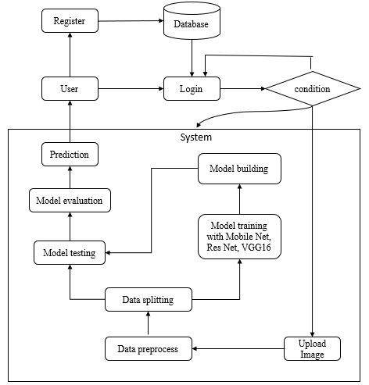
Architecture

Slide 9
Modules
Data Collection: Prepare training and testing datasets.
Data Splitting: Organize datasets for model training and evaluation.
Model Training: Optimize parameters using techniques like gradient descent.
Model Testing: Test the trained model's accuracy on unseen data.
Model Saving: Store trained models for future use.
Prediction: Predict outcomes for new medical images.
Registration: Create an account with credentials.
Login: Secure access to the system.
Upload Data: Submit medical images for analysis.
View Results: Receive real-time predictions.

Slide 10
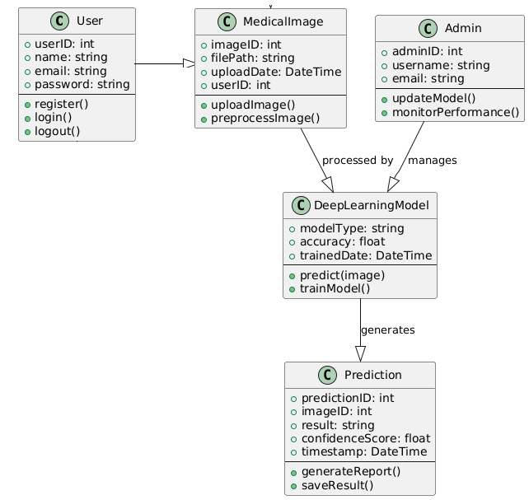
Design
(UML Diagrams)
Class Diagram

Slide 11
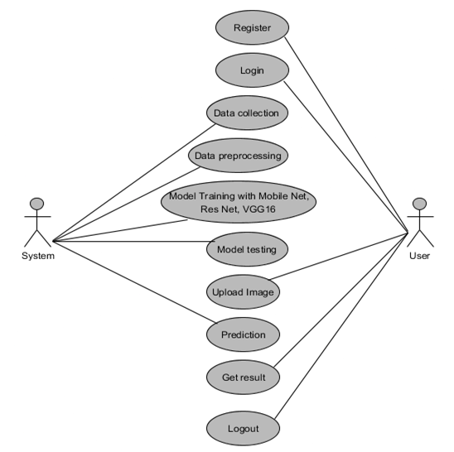
Design
(UML Diagrams)
Use Case Diagram

Slide 12
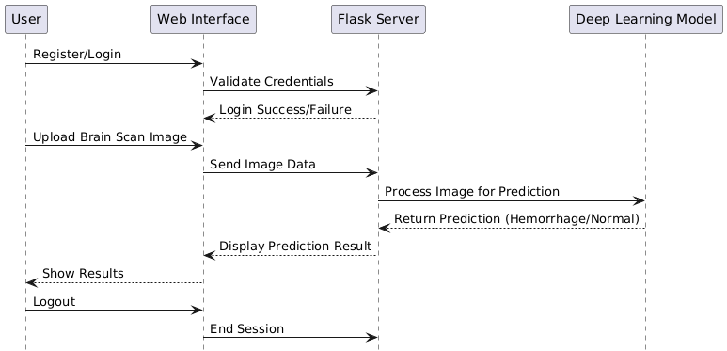
Design
(UML Diagrams)
Sequence diagram

Slide 13
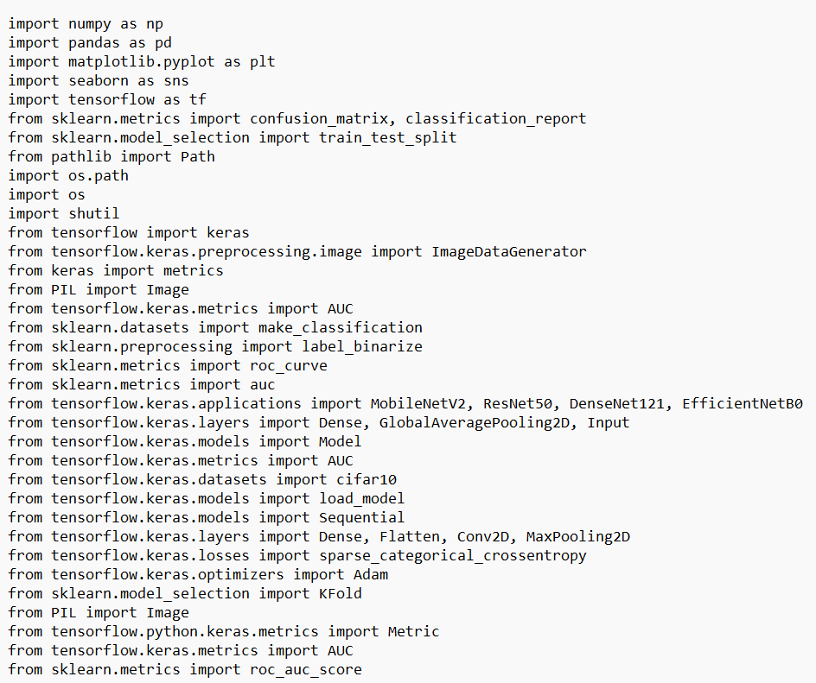
Implementation
Dataset Acquisition & Preprocessing
Collected CT scan images from publicly available medical imaging datasets. Images were resized, normalized, and augmented to improve model generalization.
Performed data augmentation (rotation, flipping, scaling) to reduce overfitting and balance classes.
Model Development
Used Convolutional Neural Networks (CNNs) to automatically extract spatial features.
Trained K-Nearest Neighbors (KNN) classifier.Used grid search for hyperparameter tuning. Implemented cross-validation for robust training.

Slide 14
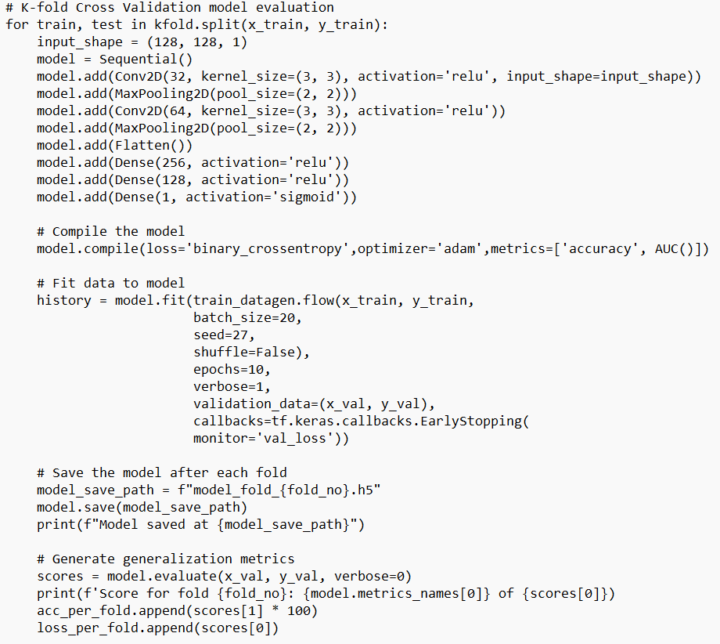
Implementation
Training & Evaluation
Models trained on GPU-enabled environments using TensorFlow & Scikit-learn.
Evaluation metrics included accuracy, precision, recall, F1-score, and confusion matrix.
Best performance observed in CNN-based models due to automatic hierarchical feature learning.
Frontend
Built using React.js for a responsive UI.
Features include CT scan upload, real-time status indicators, and result visualization.

Slide 15
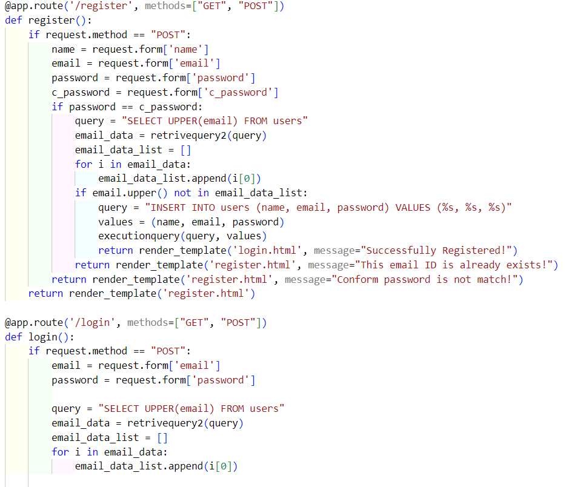
Implementation
Backend
Developed using FastAPI (Python) to serve predictions via REST APIs.
Handles image preprocessing, model inference, and response formatting.Feature Engineering.
Model Integration
Trained CNN model loaded using TensorFlow/Keras.
Automatically predicts presence and type of hemorrhage upon image upload.

Slide 16
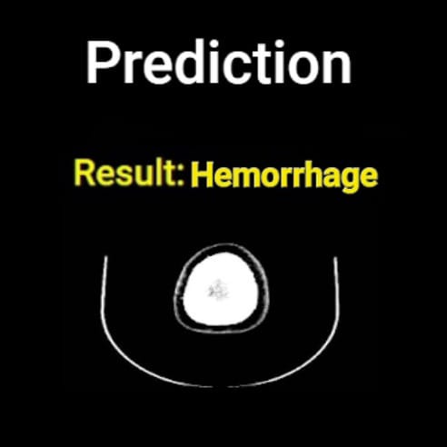
Testcases
Test Case 1: CT Scan with Hemorrhage
Input: CT scan image of a patient's brain showing hemorrhage
Expected Output:
Prediction: Hemorrhage Detected
Result: Hemorrhage correctly detected and visualized

Slide 17
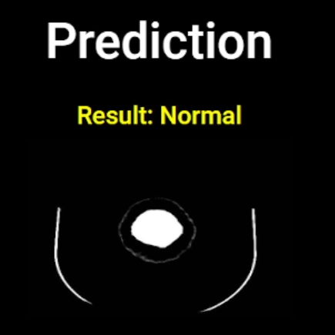
Testcases
Test Case 2: CT Scan without Hemorrhage
Input: Normal CT scan image without abnormalities
Expected Output:
Prediction: No Hemorrhage Detected
Result: Model accurately classified as non-hemorrhagic

Slide 18
Conclusion
This study highlights the potential of CNN-based approaches in automating brain hemorrhage detection, improving accuracy and speed over traditional methods.
By integrating such systems into clinical workflows, diagnostic efficiency is enhanced, reducing delays in treatment.
The developed models will pave the way for scalable, accessible solutions for healthcare, especially in resource-limited environments.

Slide 19
Future Enhancements
Expanding the dataset to include more diverse imaging modalities, improving model generalizability.
Integrating advanced preprocessing techniques and explainable AI could enhance interpretability for clinical practitioners.
Real-time deployment on low-cost devices, such as smartphones, could further increase accessibility, enabling widespread use in emergency and rural settings.

